Slide 1


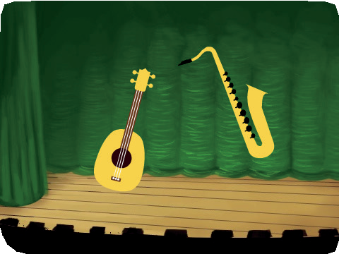
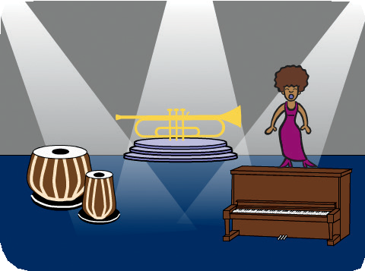
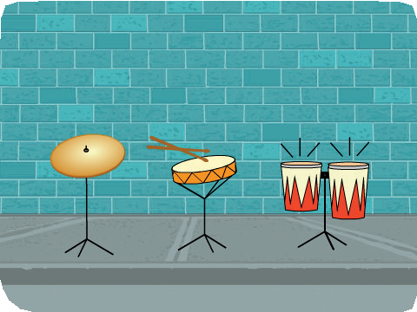
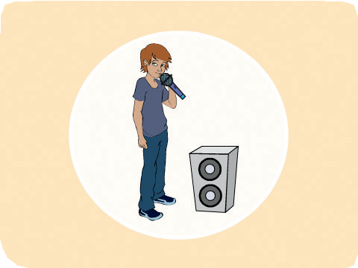

Make Music Cards
Make Music
Choose instruments, add sounds, and press keys to play music.
scratch.mit.edu/music

Slide 2
Make Music Cards
Make Music
Try these cards in any order:
Play a Drum
Make a Rhythm Animate a Drum Make a Melody Play a Chord Surprise Song Beatbox Sounds Record Sounds Play a Song
scratch.mit.edu/music

Slide 3

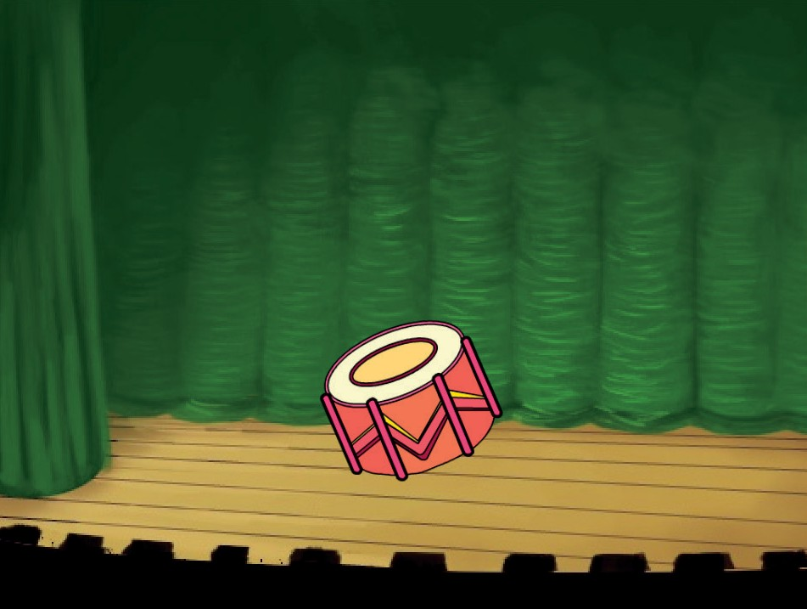
Play a Drum
Press a key to make a drum sound.
Make Music
1

Slide 4

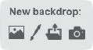
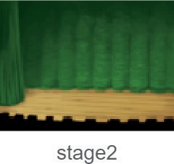
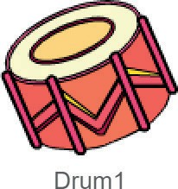

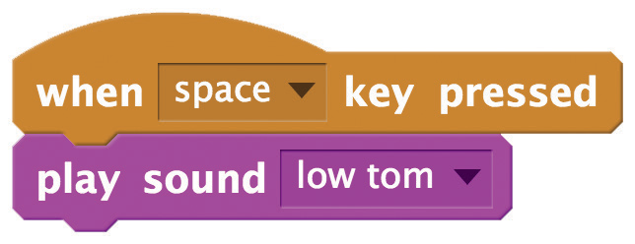
Play a Drum
scratch.mit.edu/music
GET READY
Choose a backdrop.
Choose a drum from the Music theme.
ADD THIS CODE
Select the sound you want from the menu.
TRY IT
Press the space key to start.

Slide 5
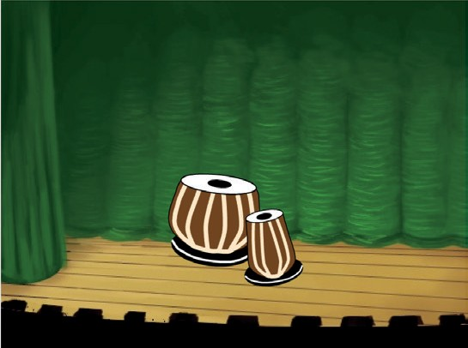
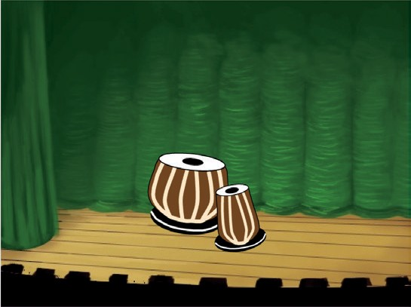
Make a Rhythm
Play a sequence of drum sounds.
Make Music
2

Slide 6
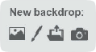
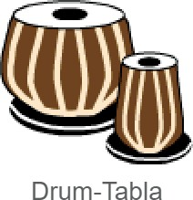

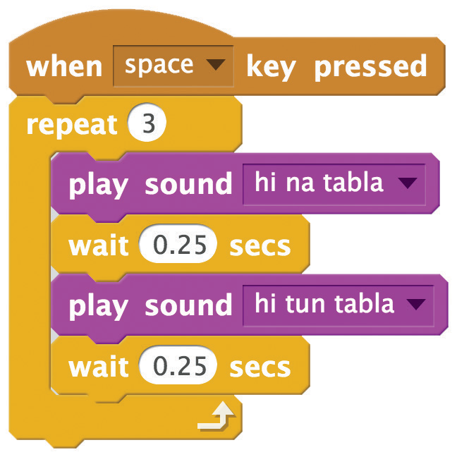
Make a Rhythm
scratch.mit.edu/music
GET READY
Choose a drum from the Music theme.
Choose a backdrop.
ADD THIS CODE
Type how many times you want to repeat.
Try different numbers
to change the rhythm.
TRY IT
Press the space key to start.

Slide 7
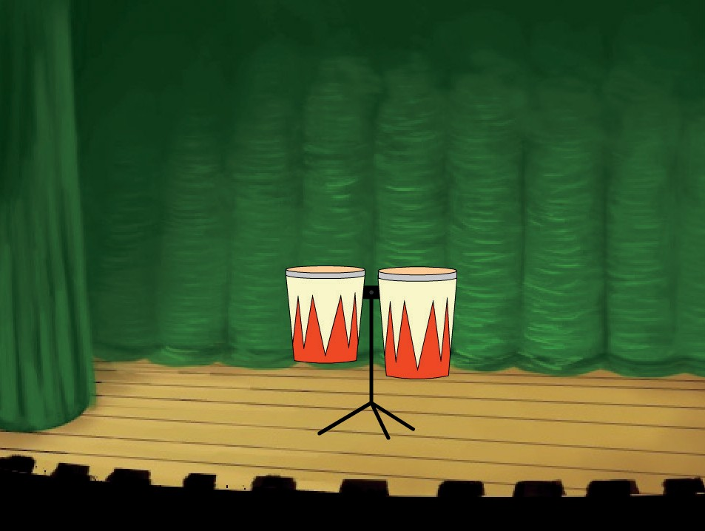
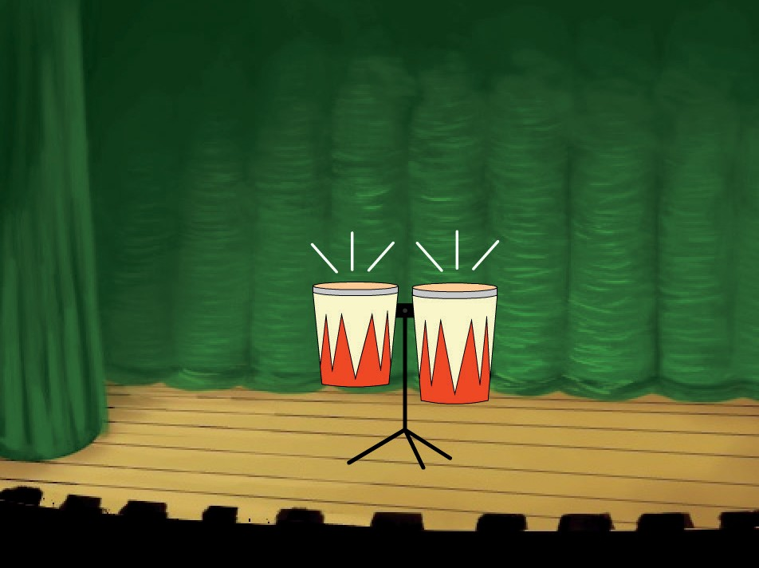
Animate a Drum
Switch between costumes to animate.
Make Music
3

Slide 8

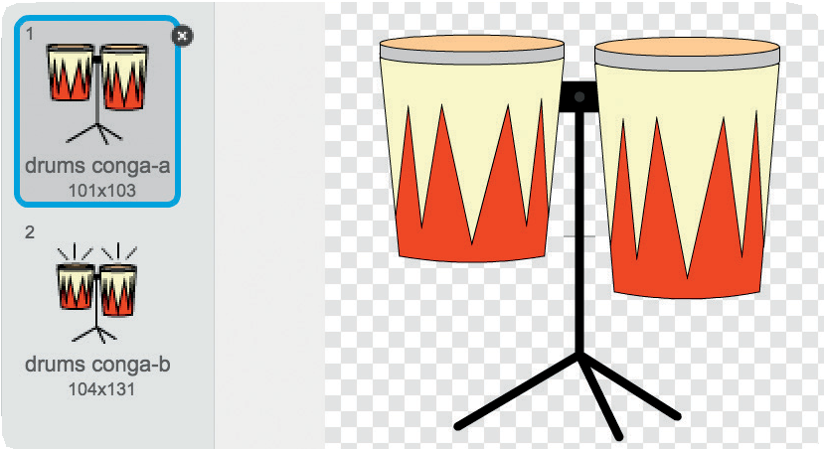

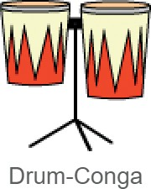

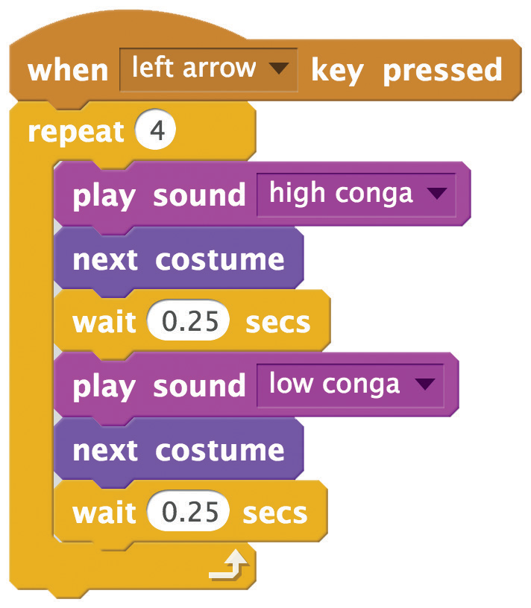
Animate a Drum
scratch.mit.edu/music
GET READY
Choose a drum from the Music theme.
Click the
tab to see the costumes.
You can use the paint tools to change colors.
ADD THIS CODE
Click the tab.
TRY IT
Press the left arrow key to start.

Slide 9
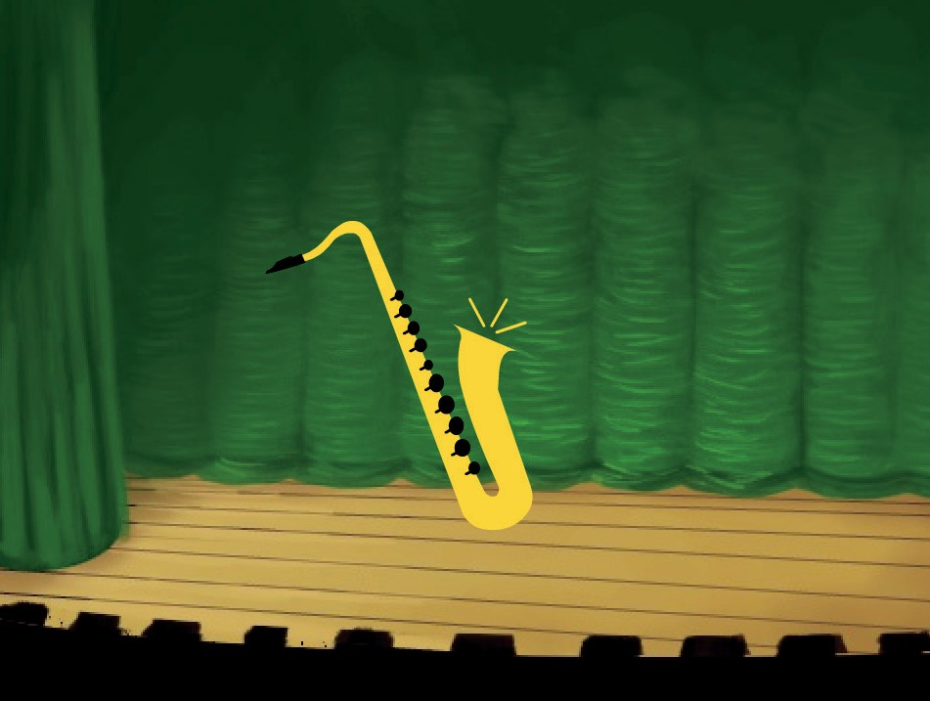
Make a Melody
Play a series of notes.
Make Music
4

Slide 10

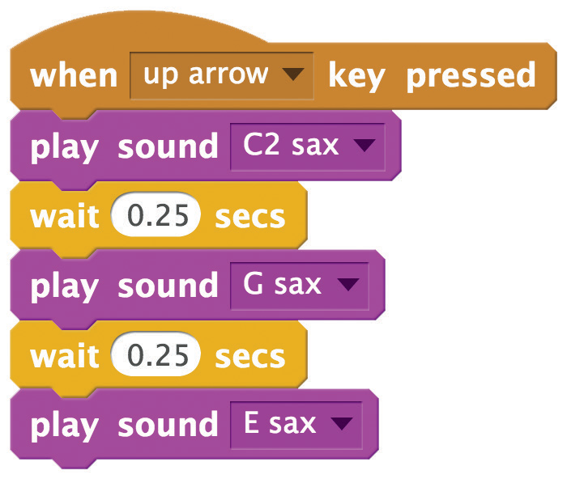
Make a Melody
scratch.mit.edu/music
GET READY
Choose an instrument from the Music theme.
Choose a backdrop.
ADD THIS CODE
Choose up arrow
(or another key).
Choose different sounds.
TRY IT
Press the up arrow key to start.

Slide 11

Play a Chord
Play more than one sound at a time to make a chord.
Make Music
5

Slide 12
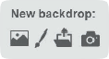
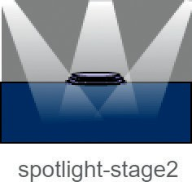
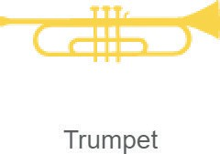
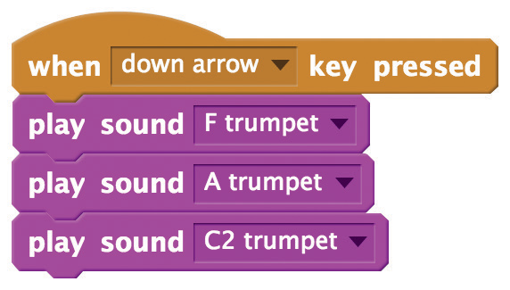


Play a Chord
scratch.mit.edu/music
GET READY
Choose an instrument from the Music theme.
Choose a backdrop.
ADD THIS CODE
Choose down arrow
(or another key).
Choose different sounds.
TIP
Use the
block to make sounds play at the same time.
Use
to play sounds one after another.

Slide 13
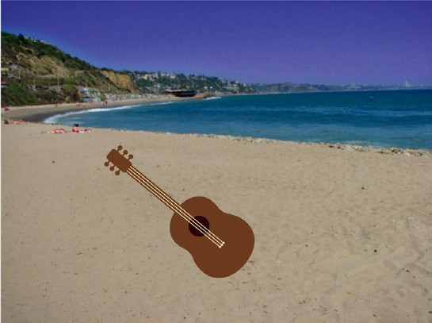
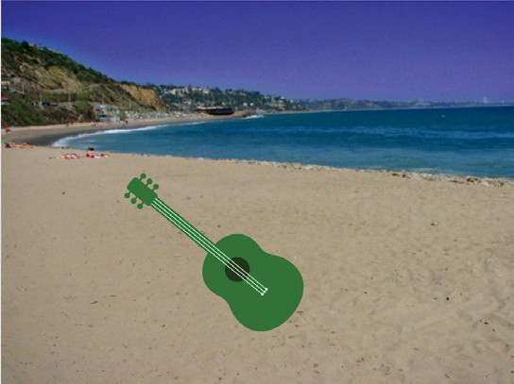
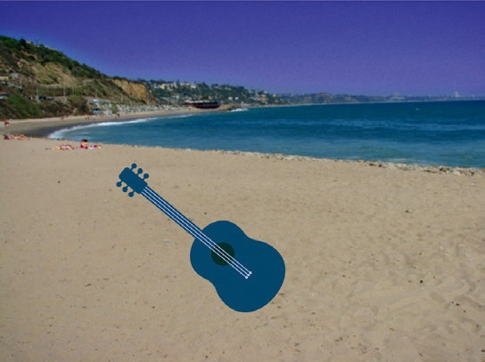
Surprise Song
Play a random sound from a list of sounds.
Make Music
6

Slide 14


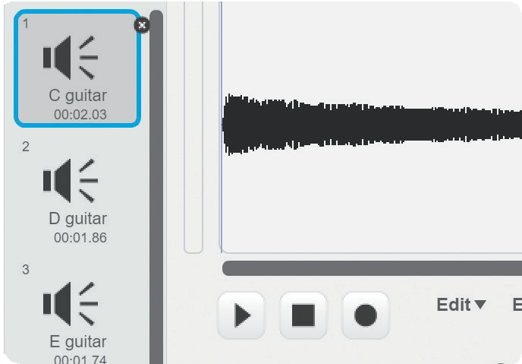
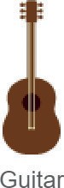
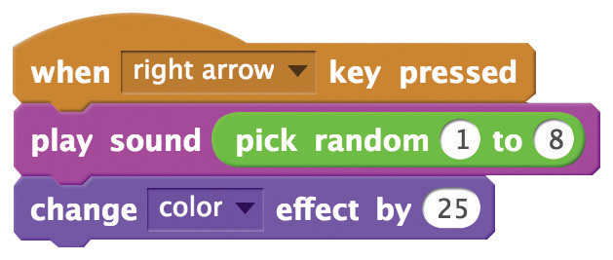
Surprise Song
scratch.mit.edu/music
GET READY
Choose an instrument from the Music theme.
Click the tab to see all the sounds of your instrument.
ADD THIS CODE
Click the tab.
Choose right arrow.
Insert a pick random block.
Type the number of sounds in your instrument.
TRY IT
Press the right arrow key to start.

Slide 15
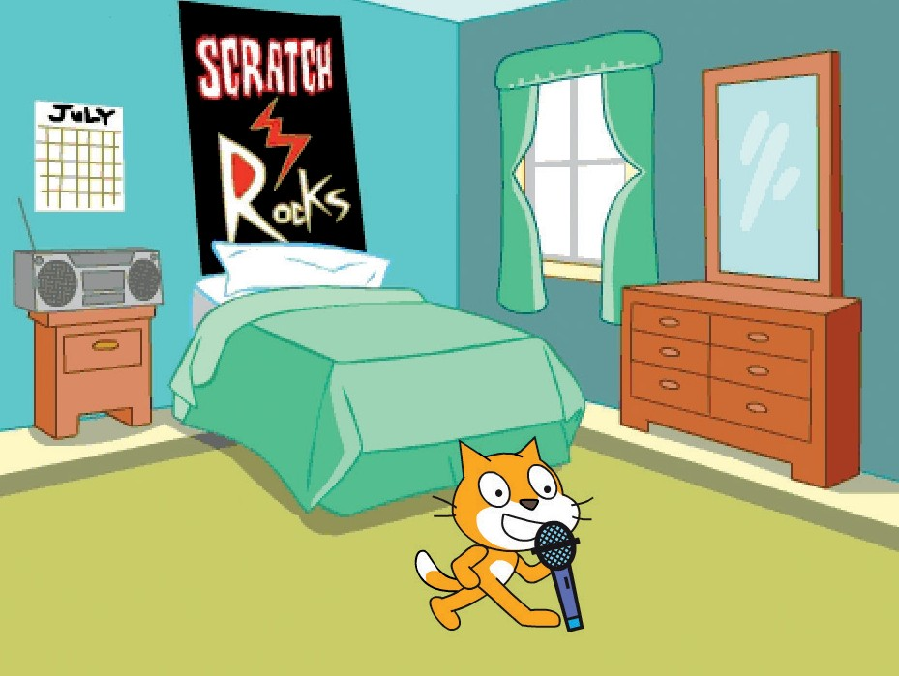
Beatbox Sounds
Play a series of vocal sounds.
Make Music
7

Slide 16

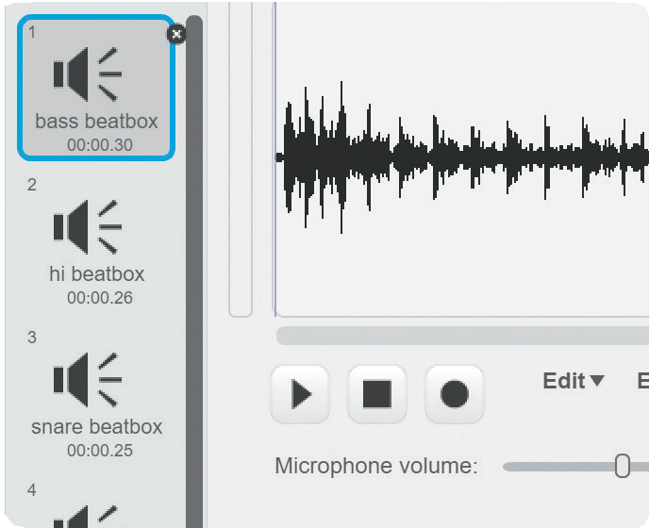

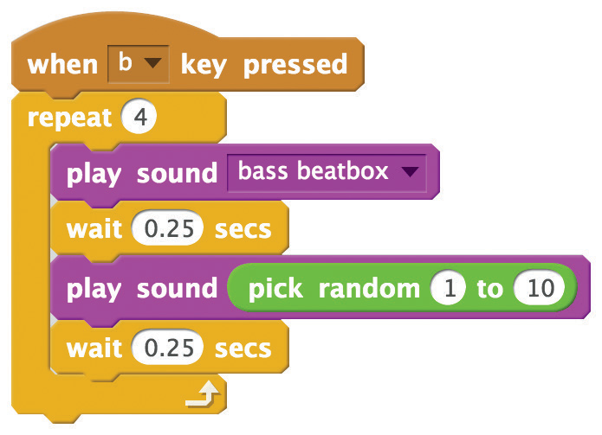
Beatbox Sounds
scratch.mit.edu/music
GET READY
Choose the Microphone.
Click the
tab to see all
the beatbox sounds.
ADD THIS CODE
Click the tab.
Choose b (or another key).
Insert a pick random block.
TRY IT
Press the B key to start.

Slide 17
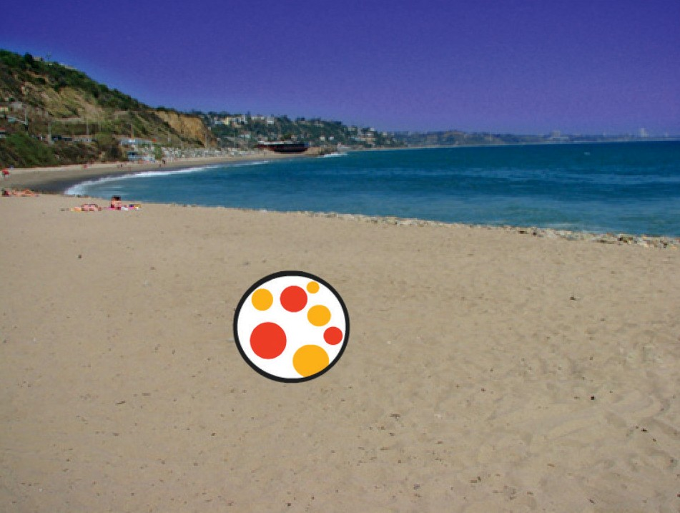
Record Sounds
Make your own sounds to play.
Make Music
8

Slide 18


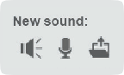
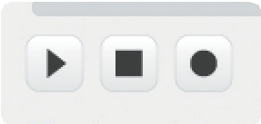
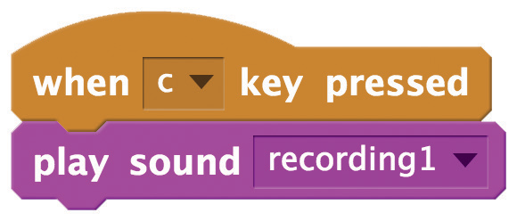
Record Sounds
scratch.mit.edu/music
GET READY
Choose any sprite you want.
Choose a backdrop.
Click the
tab.
Click this icon. (You’ll need a microphone.)
Click to record a short sound, like “boing” or “bop.”
ADD THIS CODE
Click the tab.
Choose c
(or another key).
TRY IT
Press the C key to start.

Slide 19
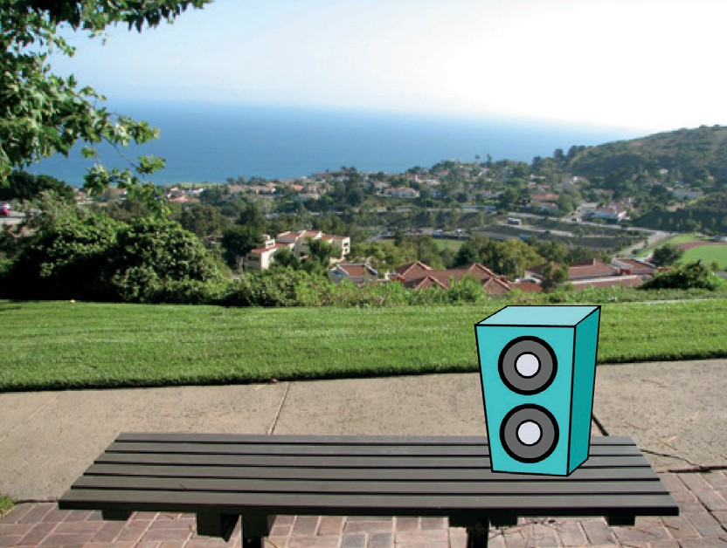
Play a Song
Add a music loop as background music.
Make Music
9

Slide 20

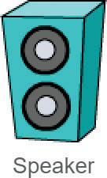
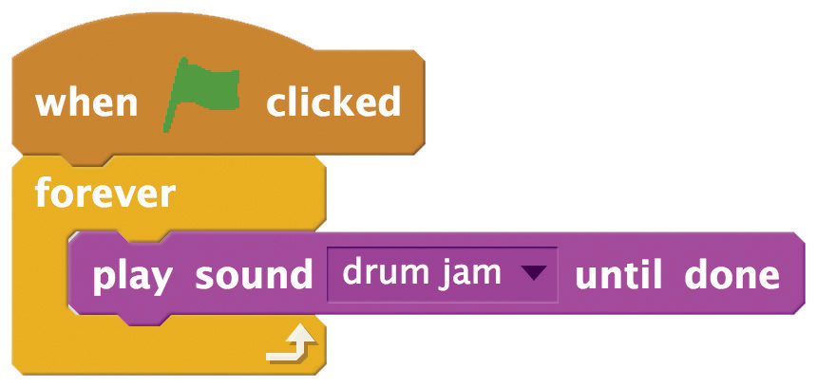
Play a Song
scratch.mit.edu/music
GET READY
Choose a sprite, like Speaker.
Click the
tab.
Select a sound from the
Music Loops category.
ADD THIS CODE
Click the tab.
TIP
Make sure to use
or else the music will interrupt itself.
(not
)

